Slide 1
C# for test automation
Exceptions.
Module 8

Slide 2
Agenda
Exceptions
Exception classes
Testing throwing of the exceptions
Practice 1
Coffee break
Finally block
Exception throwing. Re-throwing of an exception
Practice 2
Coffee break
User-defined exceptions.
Exception filtering.
Practice 3
Homework

Slide 3

exceptions
definition
An exception is an event, which occurs during the execution of a program, that disrupts the normal flow of the program's instructions.
Notes:
An exception is a problem that arises during execution of a program.
Like in the real-life, exceptional situations may lead your program to crash if they aren’t handled correctly.
Exceptions in C# give a structured way to respond to runtime errors which can occur in a .Net application.
So, C# exception is a response to an exceptional circumstance that arises while a program is running, such as an attempt to divide by zero, different hardware problems, etc.
Exceptions provide a way to transfer control from one part of a program to another.
If a program has not provided code to handle the exception, the .Net runtime system will terminate the program.
So, in the absence of an exception handler, your application will stop (crash) and present your user with a very unfriendly error message.

Slide 4
exceptions
Error handling
Prevent a program crash
Chance to retry/fix an action
Logging
Providing meaningful messages to the end user
Notes:
Prevent a program crash (prevent unhappy end users and possible data loses)
Chance to retry/fix action (for example retry network operation failed due to some network issues)
Logging (log to a log file or some logging service or API, this information can be used later in order to understand the root cause of an issue). It can be addressed by the development team
Providing meaningful messages to the end user (if we cannot fix the error a user-friendly message should be shown instead of the nasty message when the program crashes). Also, it gives an opportunity to save work in progress, and release some external resources used by the application

Slide 5
exceptions
What is .Net exception?
Exception object
System.Exception
Sources of the exception classes:
- .Net framework
- external libraries
- custom exception specific to your application
MethodA
MethodA
MethodA
MethodB
MethodB
exception
MethodC
MethodC
MethodD

Slide 6
Exceptions
Exceptions Class Hierarchy
Exception
SystemException
ApplicationException
ExternalException
NullReferenceException
ComException
ArgumentException
ArgumentNullException
InvalidOperationException
ArgumentOutOfRangeException
AccessViolationException

Slide 7
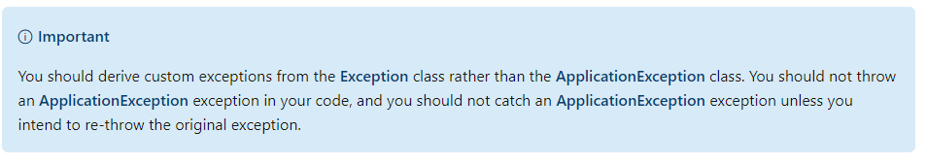
Exceptions
Application Exception Class
MSDN documentation

Slide 8
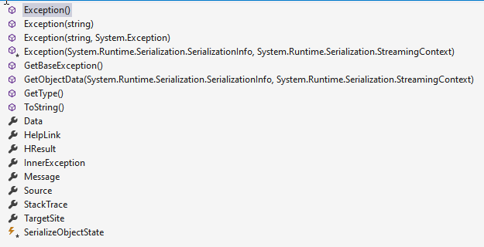
Exceptions
System.Exception

Slide 9
Exceptions
Throwing an exception
public double MyMethod() {
throw new NotImplementedException("The logic has not implemented yet");
}
static void Main(string[] args) {
CountStringLength(null); //NullReferenceException should be thrown by .Net runtime
Console.ReadKey();
}
public static int CountStringLength(string str) {
return str.Length;
}

Slide 10
exceptions
Catching exceptions. syntax
try
{
statements
}
try block: This block contains the statements being guarded for exceptions.
catch clauses: This section contains the exception handlers for exceptions thrown in the try block.
finally block: This block contains code to be executed whether or not an exception is thrown in the try block.
This section is required.
catch(…)
{
statements
}
catch(…)
{
statements
}
catch…
One or both of these sections must be present. If both sections are present, the finally block must be placed last.
finally
{
statements
}
Notes:
C# exception handling is built upon four keywords: try, catch, finally, and throw.
The try block contains the code that is being guarded for exceptions.
The catch clauses section contains one or more catch clauses. These are blocks of code to handle the exceptions. They are also known as exception handlers.
The finally block contains code to be executed under all circumstances, whether or not an exception is raised.

Slide 11
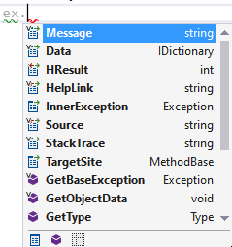
exceptions
Catch clause
Exception type
↓
Exception variable
↓
catch (DivideByZeroException ex) {
Console.WriteLine("Message: {0}", ex.Message);
Console.WriteLine("Source: {0}", ex.Source);
Console.WriteLine("Stack: {0}", ex.StackTrace);
}
Notes:
When an exception is raised, the system searches the list of catch clauses in order, and the first catch clause that matches the type of the exception object is executed. Because of this, there are two important rules in ordering the catch clauses.
An exception object contains read-only properties with information about the exception that caused it.
This information can be helpful to you for debugging your application to prevent similar exceptions from occurring in the future.
The purpose of a catch clause is to allow you to handle an exception in an elegant way. If your catch clause is of the form that takes a parameter, then the system has set the exception variable to a reference to the
exception object, which you can inspect to determine the cause of the exception. If the exception was the result of a previous exception, you can get a reference to that previous exception’s object from the variable’s InnerException property.
When an exception is raised, the system searches the list of catch clauses in order, and the first catch clause that matches the type of the exception object is executed. Because of this, there are two important rules in ordering the catch clauses.

Slide 12
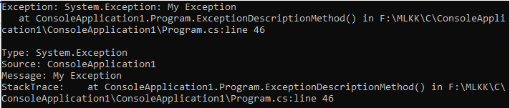
Exceptions
System.Exception
try {
throw new Exception("My Exception");
}
catch (Exception ex) {
Console.WriteLine($"Exception: {ex}");
Console.WriteLine();
Console.WriteLine($"Type: {ex.GetType()}");
Console.WriteLine($"Source: {ex.Source}");
Console.WriteLine($"Message: {ex.Message}");
Console.WriteLine($"StackTrace: {ex.StackTrace}");
Console.ReadKey();
}

Slide 13
Checking exceptions throwing
MS TEST
You can use ExpectedException attribute on top of the test method
Just specify the type of the expected exception.
[TestMethod]
[ExpectedException(typeof(DivideByZeroException))]
public void TestThatExceptionThrownWhenDivideByZero() {
var calculator = new Calculator();
calculator.Divide(42, 0);
}
MS TEST V2
[TestMethod]
public void TestThatExceptionThrownWhenDivideByZeroCheckMessage() {
var calculator = new Calculator();
var ex=Assert.ThrowsException<DivideByZeroException>(()=>calculator.Divide(42, 0));
Assert.AreEqual("You cannot divide by zero!",ex.Message);
}

Slide 14
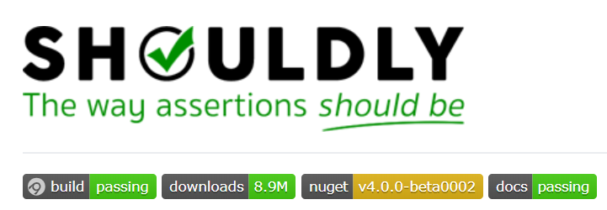
Checking exceptions throwing
SHOULDLy
Should.Throw<DivideByZeroException>(()=>calculator.Divide(42,0));

Slide 15
exceptions
Catch clause. Demo
public void Demo1Method() {
try {
int x = 42;
Console.WriteLine("Input a number: ");
string userInput = Console.ReadLine();
int y = int.Parse(userInput);
int result = x / y;
Console.WriteLine($"{x}/{y} = {result}");
Console.ReadKey();
} catch (DivideByZeroException ex) {
Console.WriteLine($"{ex.Message}");
Console.WriteLine(ex.StackTrace);
Console.ReadKey();
} catch (SystemException) {
Console.WriteLine("A System exception has occurred.{0}");
Console.ReadKey();
} catch {
Console.WriteLine("An exception has occurred.");
Console.ReadKey();
}
}
Notes:
try
{
// Code that could throw an exception.
}
catch (HttpException ex)
{
// Handles a HttpException. The exception object is stored in "ex".
}
catch (Exception)
{
// Handles any CLR exception that is not a HttpException.
// Since the exception has not been given an identifier, it cannot be referenced.
}
catch
{
// Handles anything that might be thrown, including non-CLR exceptions.
}
finally
{
// Always run when leaving the try block (including catch clauses),
// regardless of whether any exceptions were thrown or whether they were handled.
// Often used to clean up and close resources such as files handles.
// May not be run when Environment.FailsFast() is called and in other system-wide exceptions conditions (e.g. power loss),
// or when the process crashes due to an exception in another thread.
}

Slide 16
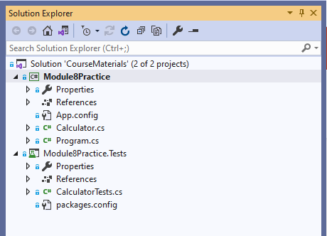
PROJECT FOR HANDS ON TASKS​
PREPARATION BEFORE THE FIRST PRACTICE ​
Clone the following git repo:​
https://github.com/d-okhrimenko/CSharpForTestAutomationMaterials.git
Or make fetch/pull if you have a local copy of this repo from the previous day.​
Checkout mod8_initial branch.

Slide 17

Practice 1
Build and run the application, check how it works, run the tests.
Enhance Calculator class. Throw ArgumentOutOfRangeException instead of writing the message to the console in the default branch of the switch statement. Do we still need to return anything inside the default branch?
Build and run the application, try to input invalid operator.
Catch the exception inside Program class, write details about this exception into the console. Run the application and check the behavior.
Add new test methods inside the test class under the test project in order to test that the exception is thrown when the invalid operator is passed. Use MS-TEST possibilities.
Add similar tests with using shoudly-syntax.

Slide 18
Practice 1
Solution
public double DoArithmeticOperation(double firstNumber, double secondNumber, string operation) {
switch (operation) {
case "+":
return Add(firstNumber, secondNumber);
case "-":
return Subtract(firstNumber, secondNumber);
default:
throw new ArgumentOutOfRangeException($"{operation} is not supported {nameof(operation)}");
}
}
try {
var result = calculator.DoArithmeticOperation(firstNumber, secondNumber, arithmeticOperator);
Console.WriteLine($"Result: {result}");
} catch (ArgumentOutOfRangeException ex) {
Console.WriteLine(ex.Message);
Console.WriteLine(ex.StackTrace);
}
[TestMethod()]
[ExpectedException(typeof(ArgumentOutOfRangeException))]
public void DoArithmeticOperationTestThatExceptionIsThrownWhenOperationInvalidMsTest() {
_calculator.DoArithmeticOperation(1.234, -5.789, "y");
}
[TestMethod()]
public void DoArithmeticOperationTestThatExceptionIsThrownWhenOperationInvalidShoudly() {
Should.Throw<ArgumentOutOfRangeException>(()=>_calculator.DoArithmeticOperation(1.234, -5.789, "y"));
}

Slide 19

Coffee Break

Slide 20

Exceptions
Catch. Finally
try {
throw new Exception("My exception");
} catch (Exception ex) {
Console.WriteLine(ex.Message);
} finally {
Console.WriteLine("Finally");
}
Notes:
The finally block will always be executed before returning to the calling code, even if a try block has a return statement or an exception is thrown in the catch block.
For example, in the following code, there is a return statement in the middle of the try block that is executed under certain conditions. This does not allow it to bypass the finally statement.

Slide 21
Exceptions
Catch. Finally. Transferring of Control
No Exceptions occurred
An Exception occurred
try
{
statements
}
try
{
statements
}
catch(…)
{
statements
}
catch(…)
{
statements
}
catch…
catch(…)
{
statements
}
catch(…)
{
statements
}
catch…
finally
{
statements
}
finally
{
statements
}
Notes:
When an exception is raised, the system searches the list of catch clauses in order, and the first catch clause that matches the type of the exception object is executed. Because of this, there are two important rules in ordering the catch clauses.
If the exception was raised in a section of code that was not guarded by a try statement or if the try statement does not have a matching exception handler, the system will have to look further for a matching handler.
It will do this by searching down the call stack, in sequence, to see whether there is an enclosing try block with a matching handler.

Slide 22

Exceptions
Finally Block
try {
int x = 42;
Console.WriteLine("Input a number: ");
string userInput = Console.ReadLine();
int y = int.Parse(userInput);
int result = x / y;
Console.WriteLine($"{x}/{y} = {result}");
} catch (DivideByZeroException ex) {
Console.WriteLine($"{ex.Message}");
Console.WriteLine(ex.StackTrace);
} catch (SystemException) {
Console.WriteLine("A System exception has occurred.");
} catch {
Console.WriteLine("An exception has occurred.");
} finally {
Console.WriteLine("Finally block is always executed");
Console.ReadKey();
}

Slide 23
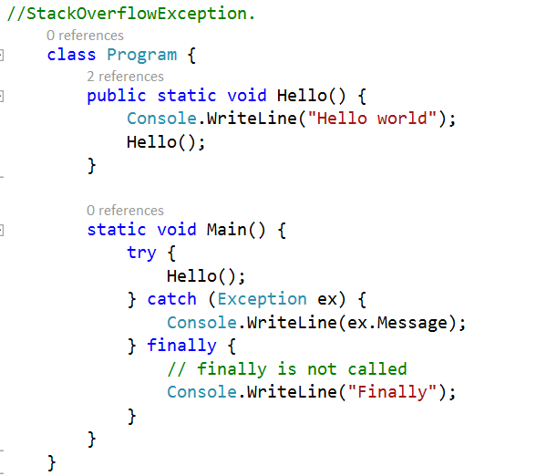
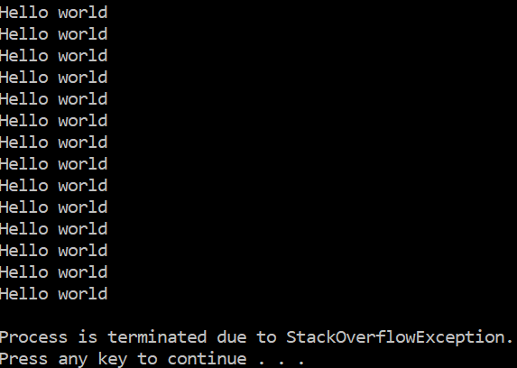
Finally Block
Stack overflow exception
Notes:
If the exception was raised in a section of code that was not guarded by a try statement or if the try statement does not have a matching exception handler, the system will have to look further for a matching handler.
It will do this by searching down the call stack, in sequence, to see whether there is an enclosing try block with a matching handler.

Slide 24
Finally Block
Working with unmanaged resources
try {
//Use of some unmanaged resources
}
// Catch the errors that can occur
finally {
//Make sure that the resources are released
}

Slide 25
Practice 2
Add new method in the Calculator class to support division operation, update DoArithmeticOperation method correspondingly.
Add tests for newly added operation. Consider cases when second number equals to zero. Which result is returned?
Dividing a floating-point value by zero doesn't throw an exception. The result is a positive infinity, negative infinity, or not a number (NaN), according to the floating-point number arithmetic. Let’s change this behavior for our calculator. Enhance division method and throw DivideByZeroException when second argument equals to zero.
Add an additional catch clause inside Program class to catch DivideByZeroException. Provide meaningful message to the console in this case.
Add logging logic in the Calculator class. Write to the console the numbers, the operator passed to the calculator and the status of the operation (was it completed successfully or not). Make sure that logging works even if an exception occurred.
Run the application, check how the logging works for different scenarios.
Put a break point inside the division method, debug a test which checks that DivideByZeroException is thrown, trace how the control is passed when an exception is “bubbling up” through the call stack.

Slide 26
Practice 2
Solution
private double Divide(double firstNumber, double secondNumber) {
if (secondNumber.Equals(0)) {
throw new DivideByZeroException();
}
return Math.Round(firstNumber / secondNumber, NUMBER_OF_DECIMALS);
}
public double DoArithmeticOperation(double firstNumber, double secondNumber, string operation) {
var isSuccess = false;
double result;
try {
switch (operation) {
case "+":
result = Add(firstNumber, secondNumber);
isSuccess = true;
break;
case "-":
result = Subtract(firstNumber, secondNumber);
isSuccess = true;
break;
case "/":
result = Divide(firstNumber, secondNumber);
isSuccess = true;
break;
default:
throw new ArgumentOutOfRangeException($"{operation} is not supported {nameof(operation)}");
}
} finally {
var statusMessage = isSuccess ? "Success!" : "Failed";
Console.WriteLine("---START LOGGING---");
Console.WriteLine($"Status: {statusMessage}");
Console.WriteLine($"Num1: {firstNumber}, Num2: {secondNumber}, Operation: {operation}");
Console.WriteLine("---STOP LOGGING---");
}
return result;
}

Slide 27
Practice 2
Solution
try {
var result = calculator.DoArithmeticOperation(firstNumber, secondNumber, arithmeticOperator);
Console.WriteLine($"Result: {result}");
}
catch (ArgumentOutOfRangeException ex) {
Console.WriteLine(ex.Message);
Console.WriteLine(ex.StackTrace);
}
catch (DivideByZeroException ex) {
Console.WriteLine("Sorry, but we cannot divide by zero");
}
[TestMethod()]
public void DoArithmeticOperationTestThatDeletionWorks() {
_calculator.DoArithmeticOperation(1.5, 2, "/").ShouldBe(0.75);
}
[TestMethod()]
public void DoArithmeticOperationTestThatExceptionIsThrownWhenDivideByZero() {
Should.Throw<DivideByZeroException>(() => _calculator.DoArithmeticOperation(1.234, 0, "/"));
}

Slide 28
Coffee Break

Slide 29

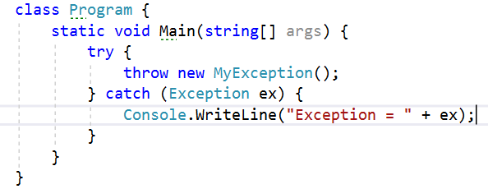
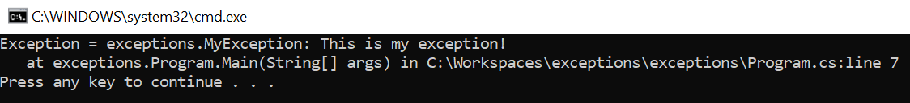
User defined exceptions
Notes:
Explain when and why

Slide 30
Catch clause
Exception Filters
public static void FirstNotImplementedMethod() {
throw new NotImplementedException("Method 1 is not implemented yet");
}
public static void SecondNotImplementedMethod() {
throw new NotImplementedException("Method 2 is not implemented yet");
}
public static void ExceptionFilterMethod() {
try {
FirstNotImplementedMethod();
} catch (NotImplementedException ex) when (ex.Message.Contains("1")) {
Console.WriteLine(ex.Message);
} catch (NotImplementedException ex) when (ex.Message.Contains("2")) {
Console.WriteLine(ex.Message);
}
Console.ReadLine();
}
Notes:
The fourth form of catch clause was added in C# 6.0 and is like the third form in that an exception object is passed into the handler, but in this case only if the object matches a specific condition, called a filter.
So instead of a single handler that addresses all possible exceptions of a particular exception type, there can be more than one handler for an exception type.
This allows you to write smaller, more focused exception handlers, without having numerous if statements inside a single handler.
Important characteristics of the when clause of a filter are the following:
• It must contain a predicate expression, which is an expression that returns a value of either true or false.
• It shouldn’t use any long-running operations.
• Any exception that occurs within the predicate expression is ignored. This makes it more difficult to debug your predicate expression, but it preserves the information needed to debug your original application error.

Slide 31
Best practices
Do not hide the errors
Avoid catch-clause without parameters
Avoid using empty catch clause
try {
// some logic is executed here
}
catch {
}

Slide 32
Best practices
rethrowing
//Application project
try {
//some core business logic is executed here
}
catch(BusinessLogicException ex) {
// we cannot to manage this exception at this application level,
// so just log the information and re-throw the exception
// to handle it on GUI-level
Console.Write(ex.Message);
throw;
// do not use
// throw ex;
// because we'll lose stack trace
}

Slide 33
Best practices
Try-Pattern vs Exceptions
public static int ReadNumberFromTheConsole() {
string userInput;
int number;
do {
Console.WriteLine("Input an integer: ");
userInput = Console.ReadLine();
} while (!int.TryParse(userInput, out number));
return number;
}

Slide 34
Practice 3
Checking exceptions throwing
Create a custom exception class for exceptional cases that can occur when working with the calculator class.
Implement two constructors in the newly added exception class:
- parameter less constructor (default message should be passed to the base class constructor)
- constructor which takes a string parameter (remember to pass it to the base class constructor).
Implement one more constructor to the custom exception class. It should take a parameter of type Exception. Use this parameter for initializing InnerException property of the base class.
Wrap up ArgumentOutOfRangeException and DivideByZeroException with newly created exception class, use these two exceptions as inner exception for the calculator exception instance.
Update Main method of the console application accordingly to the changes made in the calculator class. Use exception filtering in order to check the type of the inner exception property. Update unit tests.
(optional) Replace double.Parse with double.TryParse in the ReadNumberFromConsole method. Ask user to reenter a number if the inputted number cannot be parsed correctly.

Slide 35
Practice 3
Solution
public class CalculatorException : Exception {
private const string DefaultMessage = "Invalid operator is provided";
public CalculatorException() : base(DefaultMessage) {
}
public CalculatorException(string message) : base(message) {
}
public CalculatorException(Exception innerException) : base(DefaultMessage, innerException) {
}
}
try {
var result = calculator.DoArithmeticOperation(firstNumber, secondNumber, arithmeticOperator);
Console.WriteLine($"Result: {result}");
} catch (CalculatorException ex) when (ex.InnerException is ArgumentOutOfRangeException) {
Console.WriteLine(ex.InnerException.Message);
Console.WriteLine(ex.Message);
Console.WriteLine(ex.StackTrace);
} catch (CalculatorException ex) when (ex.InnerException is DivideByZeroException) {
Console.WriteLine("Sorry, but we cannot divide by zero");
}
Console.ReadKey();

Slide 36
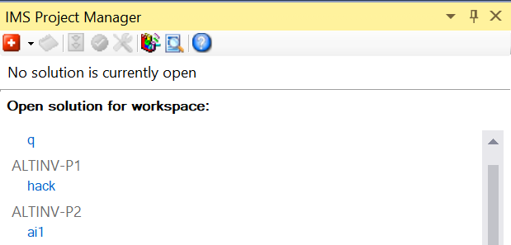
Homework
Ims project manager
https://wiki/index.php?title=IMS_Project_Manager and IMS Project Manager 2019
Watch the video: link
Notes:
The IMS Project Manager is a SimCorp extension for Visual Studio. It allows you to create a solution to work, to get the last code and to check in your code.

Slide 37
Homework

